Slide 1
Vietnam Helicopter Pilot and Crewmember Memorial
A proposal for
Arlington National Cemetery
Bob Hesselbein, President
Vietnam Helicopter Pilots Association

Slide 2
OVERVIEW
Proposed Monument
The helicopter and the Vietnam War
The human cost of helicopter warfare
Why Arlington National Cemetery?

Slide 4
DESIGN
Tablet
4’-0” X 0’8” X 3’-4”
Polished front, steeled back
Barre Granite
Base
5’-0” X 1’-2” X 0”-8”
Steeled top, 2” margin all sides
Barre Granite

Slide 5
MONUMENT PANEL
UH-1 used by all services
Crew properly positioned
Message incorporates words from Gettysburg Address …full measure of devotion…
Years of helicopter operations
Military branch seals ordered
Art by Joe Kline and Dana Morrissette

Slide 6
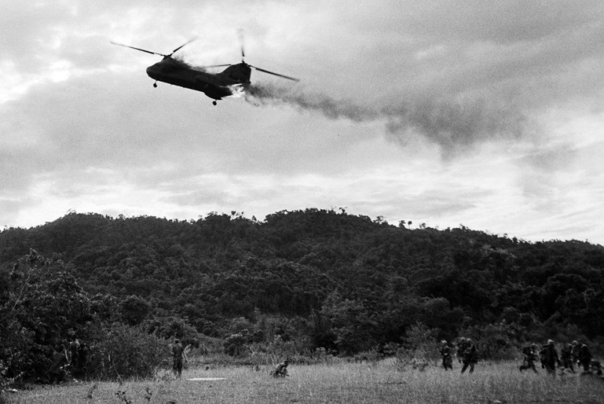
HELICOPTER FACTS
December 1961 to May 1975
Over 11,827 helicopters deployed
Estimated sorties: 2,066,000
Total destroyed: 5,086

Slide 7
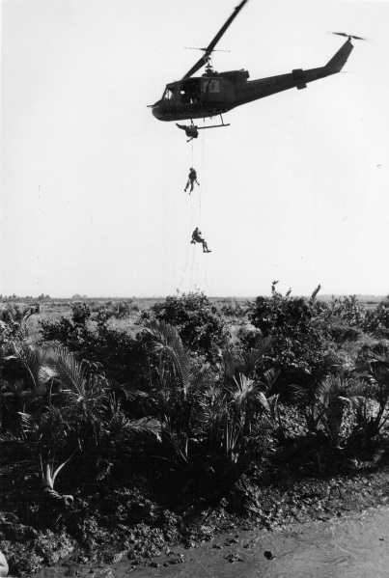
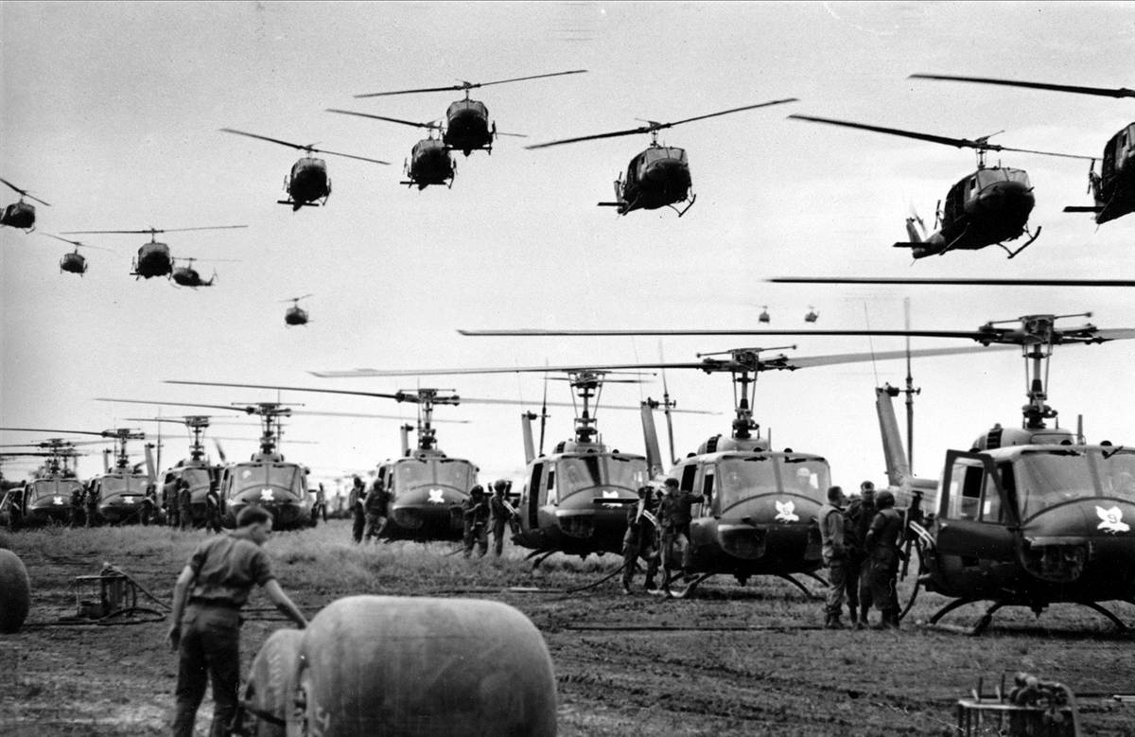
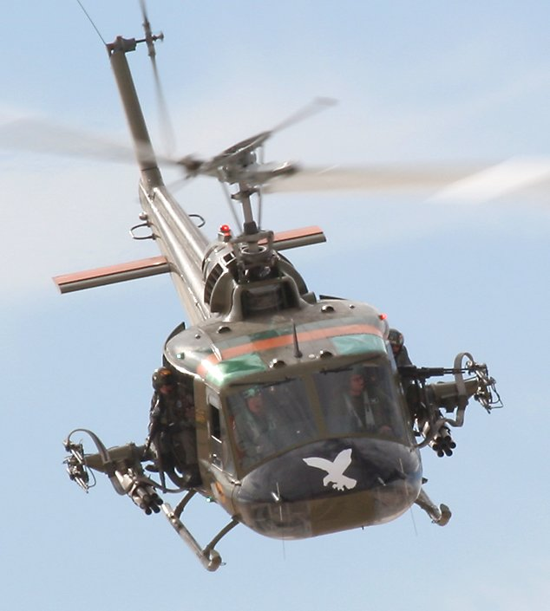
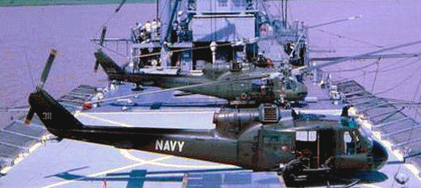
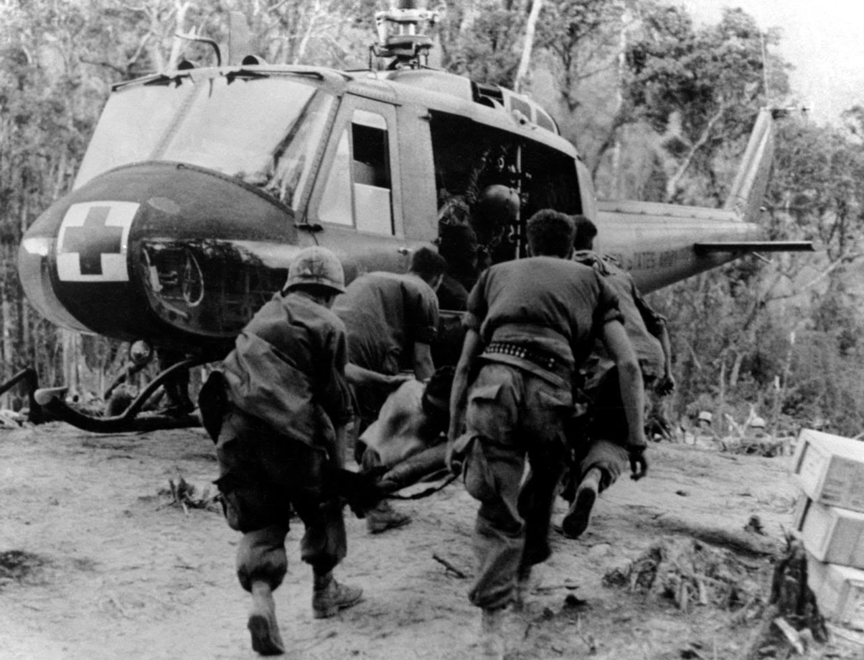
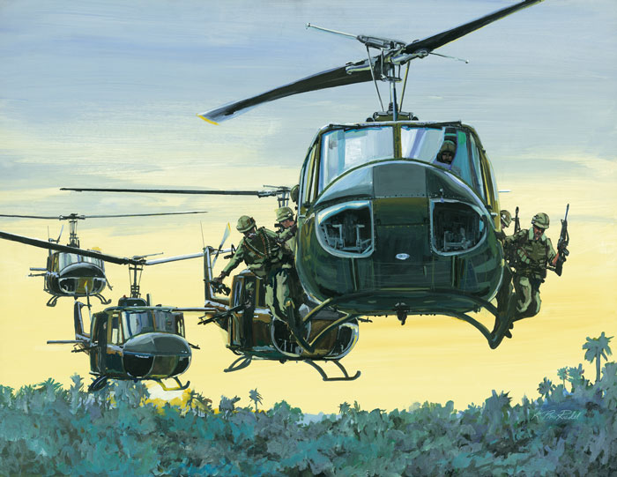
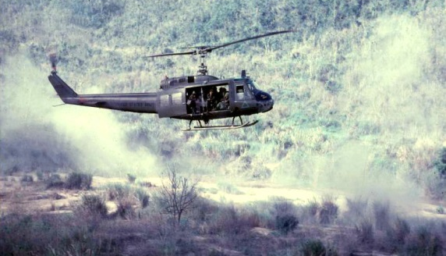
UH-1 WORKHORSE

Slide 8
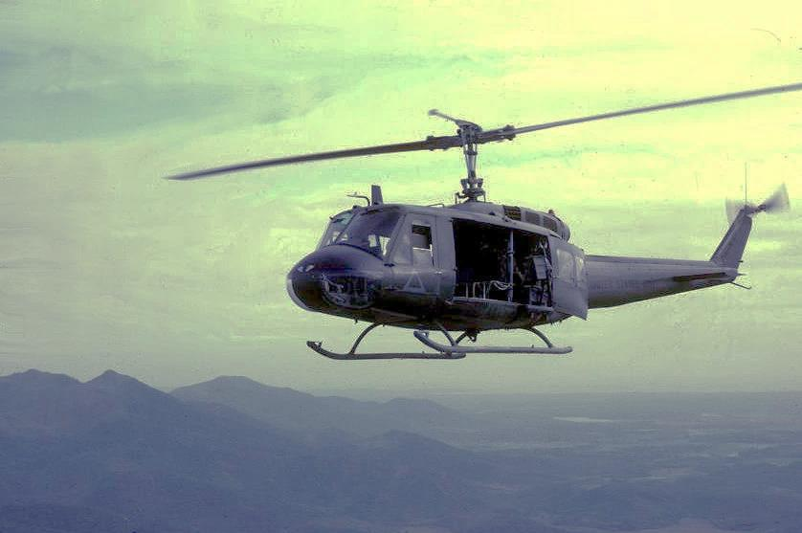
UH-1 “HUEY”
Most common--7,013 UH-1’s served in Vietnam
Used by all branches: Army, Marine Corp, Navy and Air Force
Missions: combat assault, resupply, medical evacuation, close air support, command and control, rescue and night illumination
Flight hours: 7,531,955
Destroyed: 3,305

Slide 9
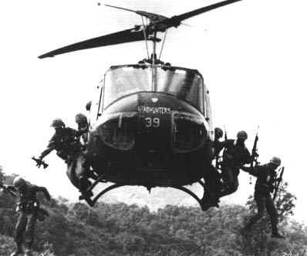
ICONIC SYMBOL
The iconic symbol of the “Helicopter War”

Slide 10
KILLED IN ACTION
Total: 58,286
Helicopter pilots: 2,002
Helicopter crewmembers: 2,704
Total rotary-wing deaths: 4,706
Percent of all killed in action: 9%

Slide 11
KIA WITHIN ANC
VN Casualties immediately buried: 2,590 (1)
Helicopter pilots: 205
Helicopter crewmembers: 252
Percent of war casualties: 18%
(1) Coffelt Group Database

Slide 12
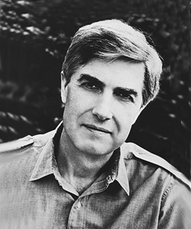
WHY THIS MEMORIAL?
“The aviation units were the sole combat element… that did not come apart under the stress of the war in Vietnam…
Whether it was the oneness of man and the acrobatic flying machine, whether it was the equally shared risk of officer pilot and enlisted crew member, whatever the reason, the men of the helicopters kept their discipline and their spirit.”
Neil Sheehan – A Bright Shining Lie
“Persistent Valor”

Slide 13
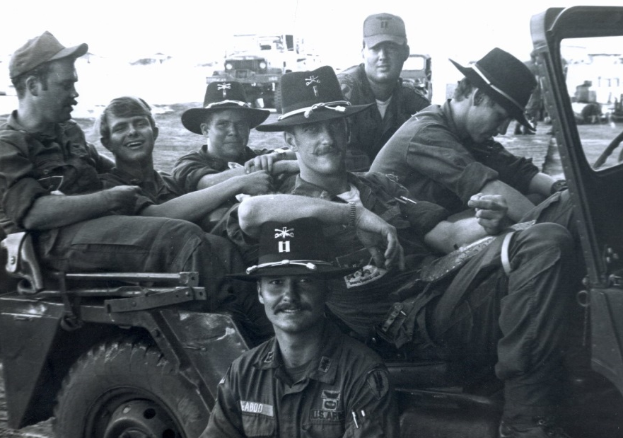
WHY THIS MEMORIAL?
No national memorial exists anywhere that recognizes the shared, common valor of all helicopter pilots and crewmembers who gave the last full measure of devotion to their nation in the Vietnam War.

Slide 14
WHY ARLINGTON NATIONAL CEMETERY?
Helicopter casualties from all branches are within the cemetery
Medal of Honor recipients rest in ANC
Recovered MIA helicopter crews are honored
“Where the nation comes to remember
and honor our military dead”

Slide 15
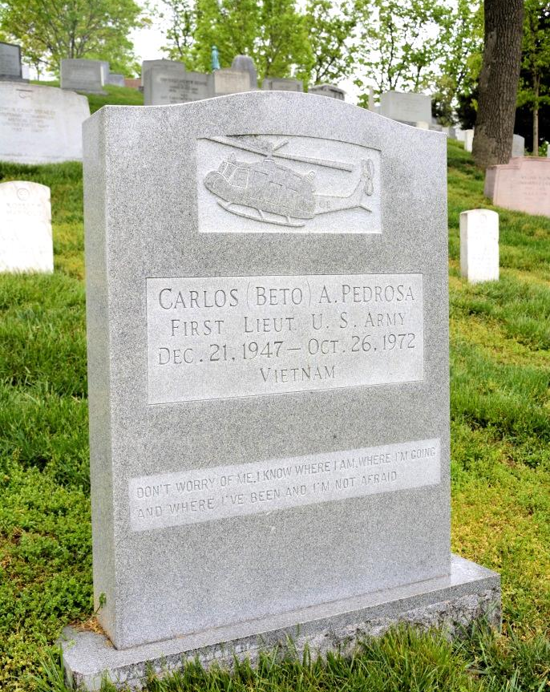
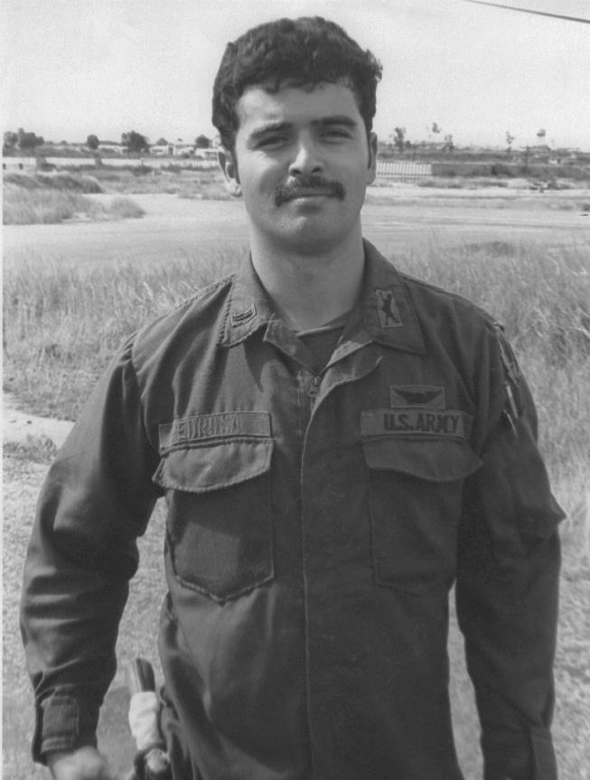
UNIQUE REMEMBRANCES
“Don’t worry about me, I know where I am, where I‘m going and where I’ve been, and I am not afraid.” – from a letter home
Carlos Pedrosa

Slide 16
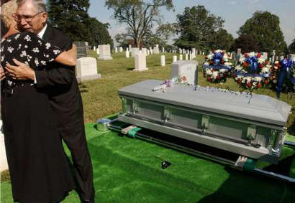
HONOR ALL BRANCHES
Jack C. Rittichier, USCG
Jolly Green 23
KIA/BNR 9 JUN 1968
Buried 6 OCT 2003

Slide 17
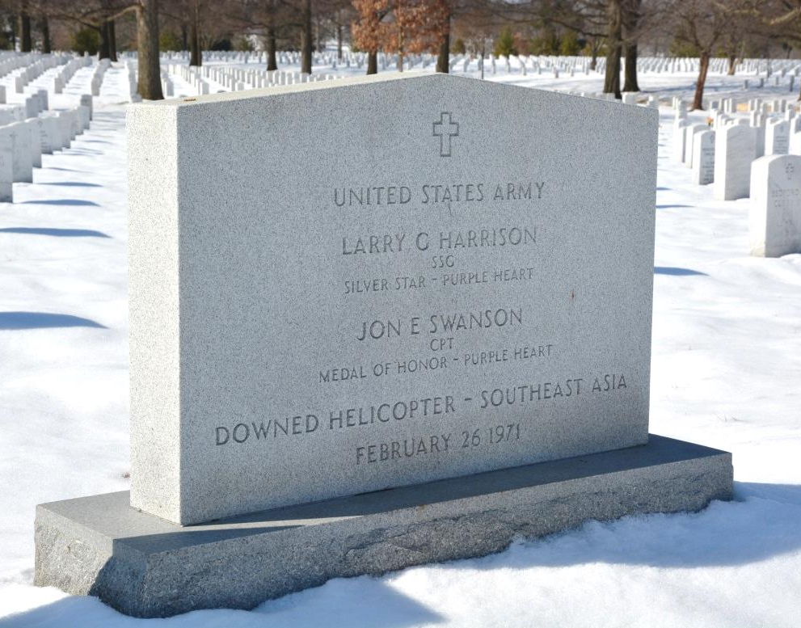
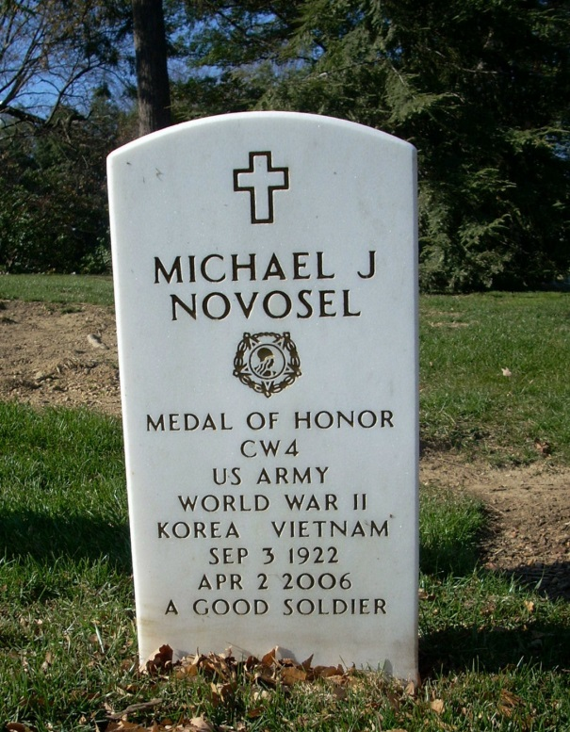
MEDAL OF HONOR RECIPIENTS
Jon E Swanson
KIA/BNR 26 FEB 1971
buried 2002
(Larry G Harrison)
Michael J Novosel
Buried 2006

Slide 18
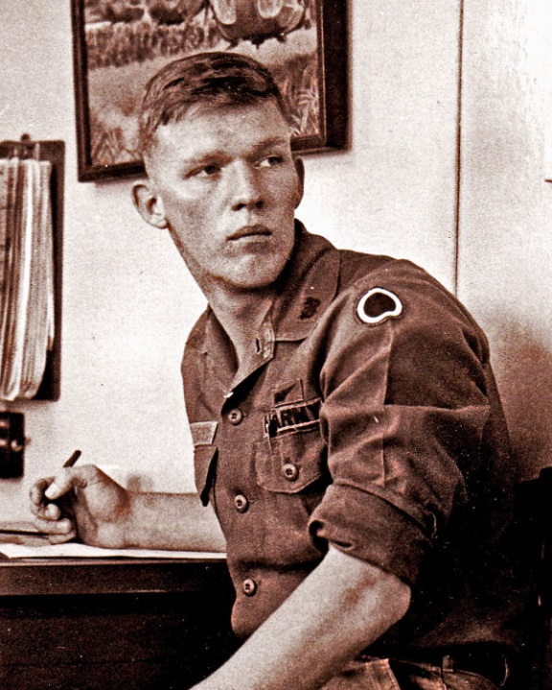
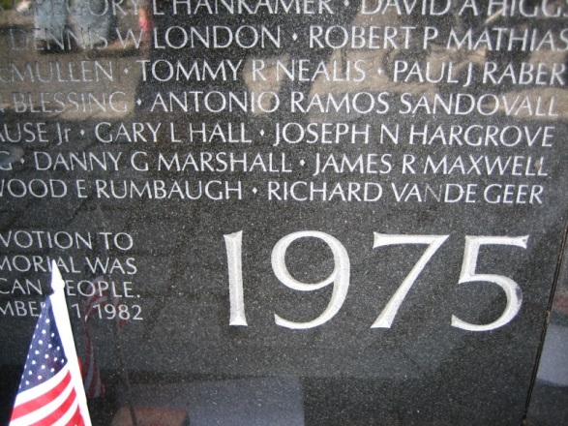
TO HONOR THE LAST
KIA/BNR
15 May 1975
Interred
27 October 2000
Richard Vande Geer
21st Special Operations Squadron, USAF

Slide 19
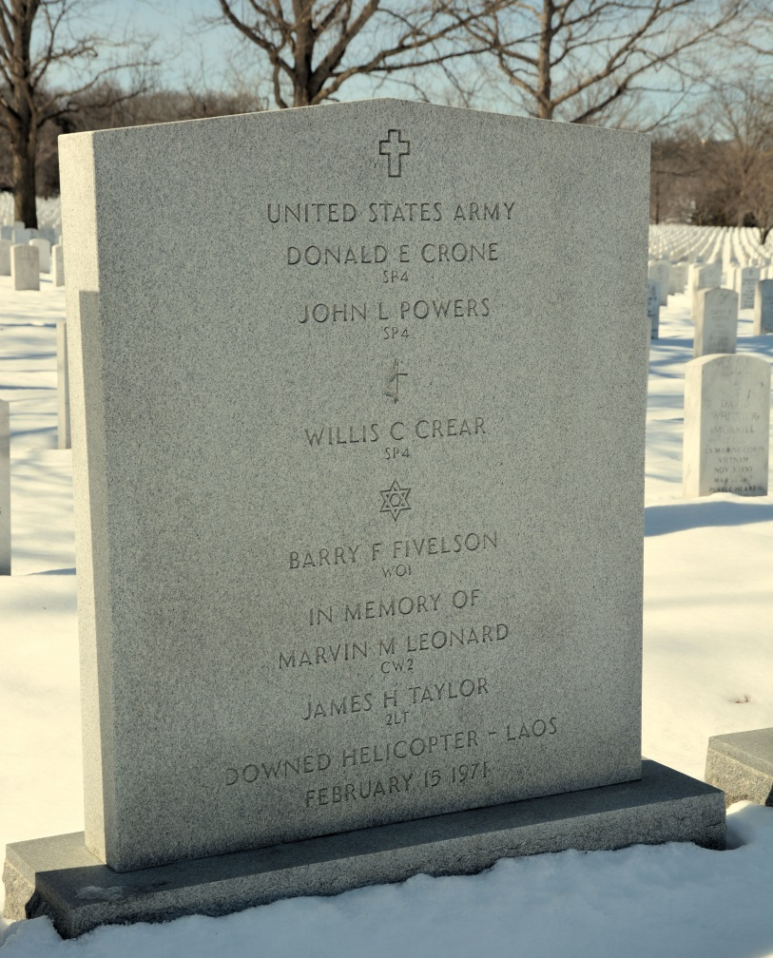
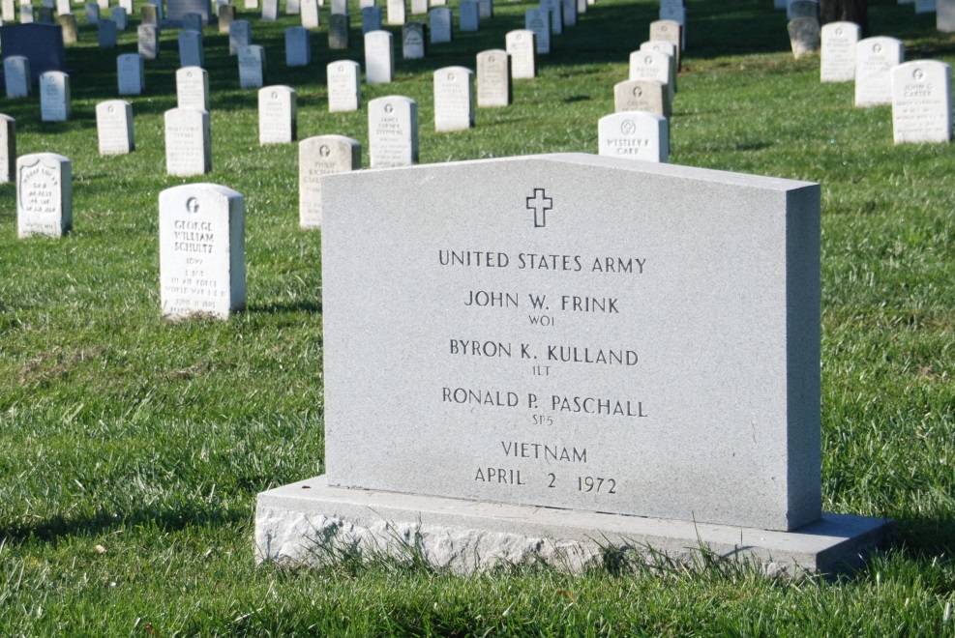
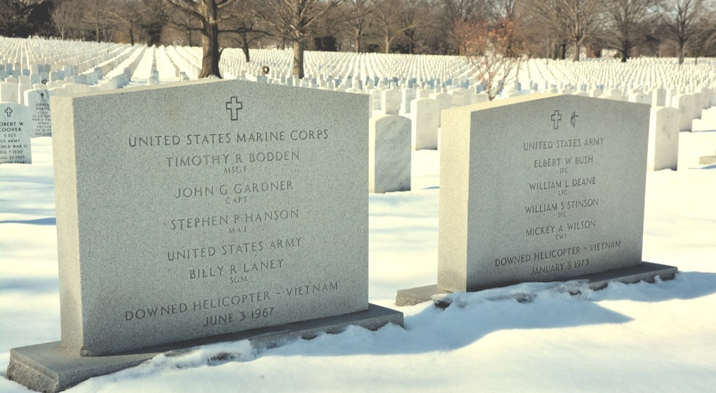
HONOR THE RECOVERED

Slide 20
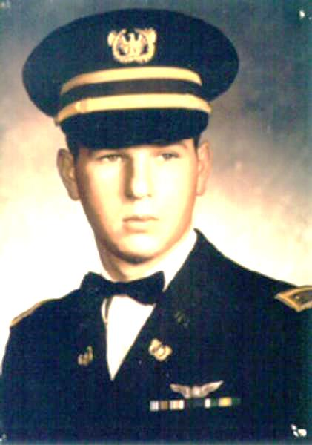
HONOR FUTURE MIA INTERMENTS
KIA/BNR 9 JAN 1968
WO1 James Phipps*
WO1 Ranier Ramos
SP4 Warren Newton
SP4 Fred Secrist
Scheduled Interment
17 JUN 2015
Troop C, 7/17th Cavalry
“Blue Ghosts”

Slide 21
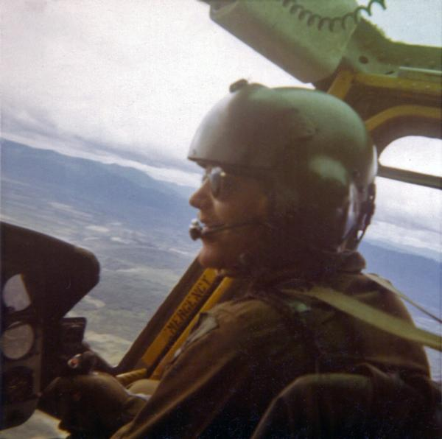
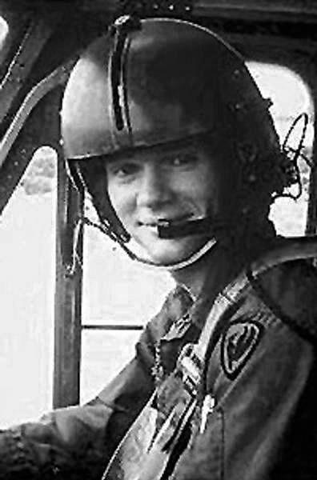
TO HONOR THOSE FOREVER LOST
KIA/BNR 24 May 1972
1LT James Hunsicker
WO1 Wade Ellen
Downed
Dak Poko River
57th Assault Helicopter Company
“Gladiators”

Slide 22
FOR ALL THE RIGHT REASONS
The proper location within the heart of the nation…
The numbers interred…
The commonality without regard to rank or military branch…
To recognize their honor, service and sacrifice…
No other military cemetery is suitable

Slide 23
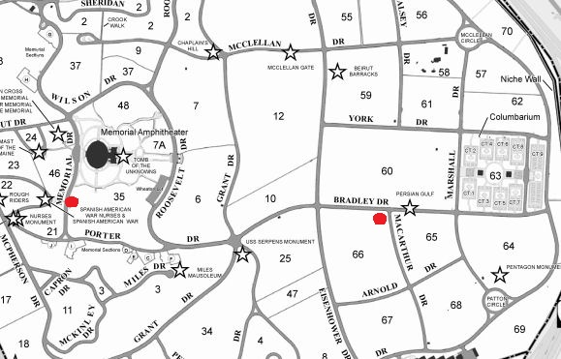
PLACEMENT
OPTION A
Section 66,
northeast corner
Panel faces northeast towards recovered MIA markers (Sect. 60)

Slide 24
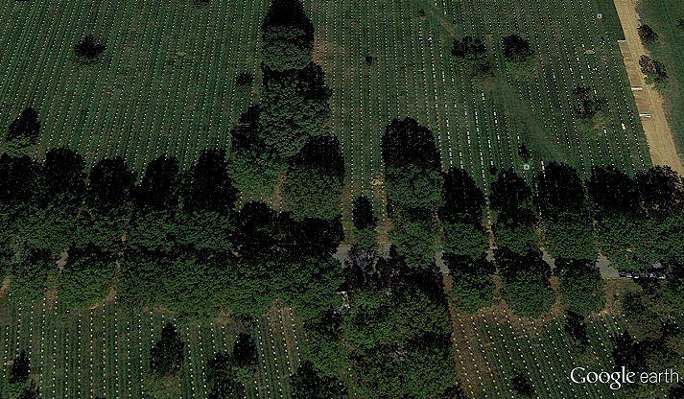
PLACEMENT
OPTION A
Section 66,
northeast corner
Panel faces northeast towards recovered MIA markers (Sect. 60)
Approaching the recovered crews

Slide 25
PLACEMENT
OPTION B
Section 35, Memorial Dr.
Panel faces west
Adjacent to living tree
Near other memorials

Slide 26
NEXT STEPS
United States Commission of Fine Arts
Meeting Schedule
16 April (filing deadline 2 April)
21 May (filing deadline 7 May)
18 June (filing deadline 4 June)
Congressional Review
(60 days)

Slide 27
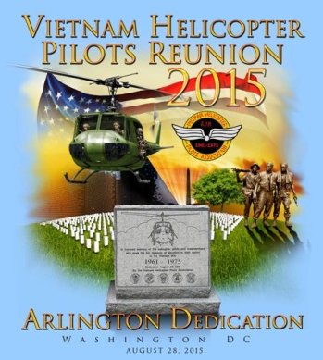
2015 THE LAST GREAT GATHERING
Average veteran age: 72
50th Commemoration
All invited to participate
Attendees: 8,000 – 12,000
Dedication Ceremony
August 28th, 2015
Notes:
1913 Gettysburg reunion was the 50th remembrance of the battle. Largest gathering of CW veterans.

Slide 28
ARLINGTON NATIONAL CEMETERY
The best location to honor all helicopter pilots and crewmembers buried during the Vietnam War…
and ever since.

Slide 29
QUESTIONS?
Bob Hesselbein, President
Vietnam Helicopter Pilots Association
bobhesselbein@vhpa.org
608.628.9024

