Slide 1
Association of Marital Status with Vascular Disease in different Arterial Territories: A Population Based Study of Over 3.5 Million Subjects
Carlos L. Alviar MD, Caron B Rockman MD, Yu Guo MA, Mark A. Adelman MD, Jeffrey S. Berger MD MS
Leon H. Charney Division of Cardiology
NYU Langone Medical Center
New York, New York
The authors have no financial disclosures
Notes:
Thank you very much Dr. Bittner

Slide 2
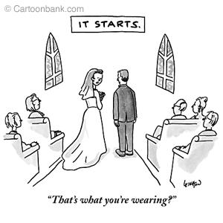
Does marital status influence your cardiovascular health?
Prior studies have reported an interaction between marriage and health
Cardiovascular disease, risk factors and outcomes vary by marital status.
Limited available literature:
Conflicting data
Smaller cohorts
Data mostly on married vs. unmarried subjects
Most studies focus on coronary disease only
No worries, according to scientist despite the extra pounds coming up, your heart will be in good shape!
Do the patterns of risk factors and vascular disease vary by marital status?
Jaffe DH et al . Ann Epidemiol 2007;17:540-7
Hadi Khafaji HA et al Clin Cardiol 2012;35:741-8
Notes:
I hope that with this brief presentation we can resolve the question Does marital status play role in your cardiovascular health?
So let’s start with a little bit of the background for this topic. Prior research has described an association between marital status and health, with evidence showing that cardiovascular disease as well as risk factors for cardiovascular disease vary between marital status.
Nonetheless previously published studies display several limitations, including conflicting results between publications, or studies with limited number of participants (the largest being a meta-analysis combining 40 studies with a total pooled sample size of about 250,000 subjects). Notably, most of the prior research has compared only married to unmarried subjects, without making the distinction between different marital statuses. Also the studies in this field have mostly focused on assessing the association between marriage and coronary disease –meaning limited only to the vessels in the heart- leaving us with only scant information in terms of vascular disease in other areas of the body.
Therefore we wanted to investigate if the patters of risk factors for cardiovascular disease as well as the presence of cardvascular disease vary by marital status in a large population with over 3.5 million subjects

Slide 3
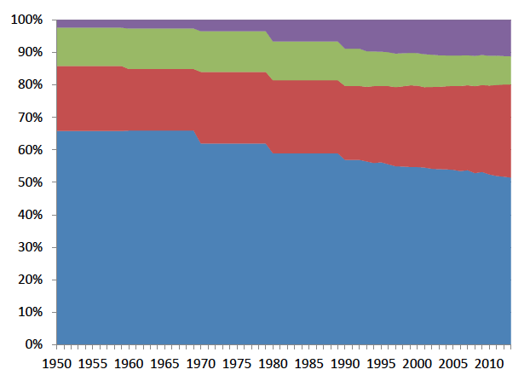
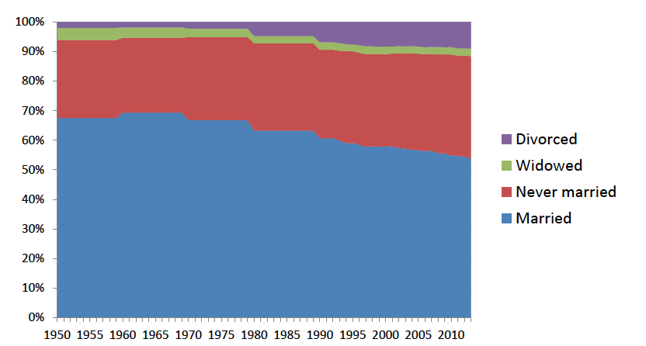
Marital Status Distribution
In the US (1950-2013):
Men
Women
In our cohort:
Men
Women
6%
10.5%
5%
18.2%
9%
8.1%
80%
63.2 %
www.census.gov/hhes/families/data/marital.html.
Notes:
For this purpose we use a large database which consisted primarily of self-referred people who participated in the Life Line Screening program, which was carried on at more than 20,000 screening sites between 2003 and 2008 representing all 50 states in a broad geographical and socioeconomic distribution. Mean age for our database 64 years and 63% of the participants were women (age 21-99)
These graphs illustrate the distribution of marital status in the US (upper graphs) and in our cohort (lower pies).
As you can observe, marital status distribution in our subjects was comparable with the general US population, among men, 8.8% were single; 80% were married; 6.1% were divorced and 4.7% were widowed
Among women, 8.1% were single; 63% were married; 10.5% were divorced and 18% were widowed.,
-----------------------
The breakdown of race/ethnicity in the cohort consisted of 88.9% white, 3.1% black, 2.4% Hispanic, 2% Asian, 2.9% Native American and 0.6% of other race
While the percent of minorities was low, there were 110,190 Blacks, 85,308 Hispanics, 71,090 Asians, and 103,081 Native Americans
Overall, 292,670 (8.3%) subjects were single; 2,442,621 (69.1%) were married; 319,321 (9%) were divorced and 477,577 (13.5%) were widowed
According to the 2010 US Census
Among men > 40 years of age: 11.5% were single, 72 % were married, 12% divorced and 4.3% widowed
Among women > 40 years of age: 8.5% were single, 61% married, 15% divorced and 15% widowed

Slide 4
CV Risk Factors
Notes:
This is the distribution of risk factors among marital status according to our findings. Let me walk you through these graphs.
In the upper graphs we have risk factors related to other medical conditions considered to be risk factors of cardiovascular disease (high blood pressure and high cholesterol on the left and DM on the right), in the left lower figure we have other traditional risk factors such as family history of cardiovascular disease as well as physical activity and obesity; and in the figure on the right lower side we display the presence of smoking as risk factor divided in current, former and never smokers.
Overall, we found that traditional risk factors in our subjects were similar to the US population. **for example if you look at the blue bars in the upper left, we found that high blood pressure was more common in widowed subjects, which was also the case for high cholesterol levels (red bars in the upper left) and diabetes (purple bars on the upper right), similarly low levels of exercise were also most commonly seen in widowed individuals as shown by the blue-green bars in the left lower graph . On the other hand being a current smoker was more frequently reported in divorced individuals, while widowed subjects displayed the lowest presence of current smoking. Interestingly, obesity and family history of cardiovascular disease were most common in single and divorced subjects respectively

Slide 5
Risk of Cardiovascular Disease
By Marital Status
Any vascular disease
Abdominal Aortic
Aneurism
Coronary Artery
Disease
Cerebrovascular
Disease
Peripheral Arterial
Disease
*Single status used as reference
Notes:
This graph illustrate the main findings of our study. After multivariable adjustment for factors that could affect the presence of cardiovascular disease (age, gender, obesity, diabetes, high blood pressure, high cholesterol, lack of exercise and family history), we found that marital status was indeed independently associated with the presence of cardiovascular disease. For instance when compared to single individuals, married subjects had a significant 5% lower odds of any vascular disease. This finding remained constant across different types of vascular territories, with married individuals having a 9% lower odds of abdominal aortic aneurism (AAA), 8% lower odds of Cerebrovascular disease (CVD) and 19% lower odds of Peripheral Arterial Disease (PAD). Conversely, the odds of different types of cardiovascular disease were higher in divorced and widowed subjects when compared to single individuals
CAD was not objectively measured
After multivariable adjustment for factors that could affect the presence of cardiovascular disease (age, gender, obesity, diabetes, hypertension, high cholesterol, physical activity and family history), we found that marital status was indeed independently associated with the presence of cardiovascular disease. For instance married subjects had a significant 5% lower odds of any vascular disease when compared to single individuals. When analyzed by other vascular territories, married individuals had a 9% lower odds of abdominal aortic aneurism (AAA), 8% lower odds of Cerebrovascular disease (CVD) and 19% lower odds of Peripheral Arterial Disease (PAD).

Slide 6
Conclusions
In a very large contemporary cohort, being married was associated with lower odds of cardiovascular disease when compared to single
Both widowed or divorced subjects had a higher prevalence of cardiovascular disease than subjects who were single
This association was demonstrated in both women and men
The lower odds of any vascular disease in married subjects were more pronounced at younger ages
Further research in necessary to establish potential explanation for the present findings
Here is the deal: Stay married or put yourself at risk…

